Slide 1
EDA Presentation

Slide 2

Resume Information Extraction
Benefits:
Automating workflows.
Time saved.
Talent identification eased.

Slide 3
Statistical Analysis of the Data

Slide 4
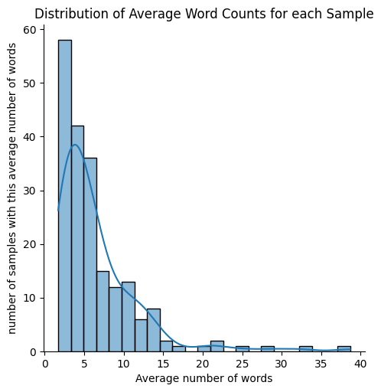
The average number of extracted words is around 5.

Slide 5
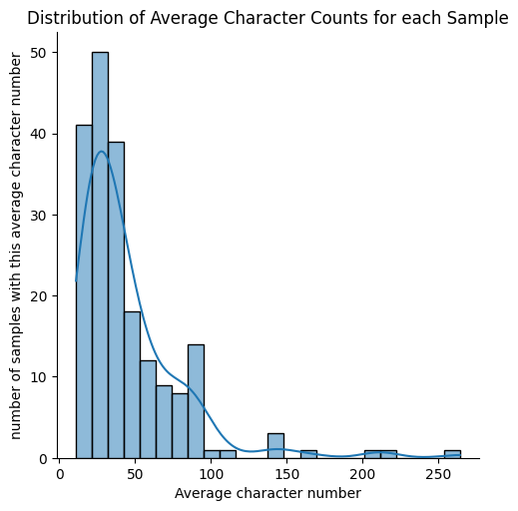
Average character counts is around 30

Slide 6
Proposed Modeling technique
Sequential embeddings of tokens from the input text and similarity comparisons with a general semantic embedding of skills.

Slide 7
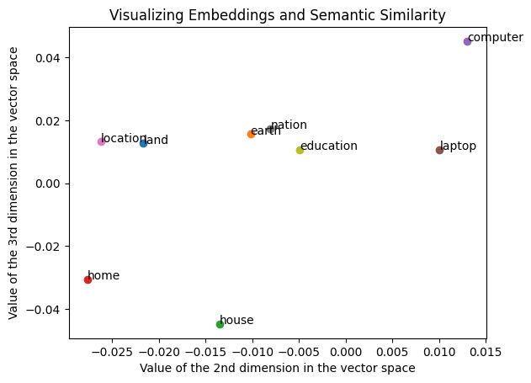
We want words with similar semantic meanings to have a similar vector representation.

Slide 8
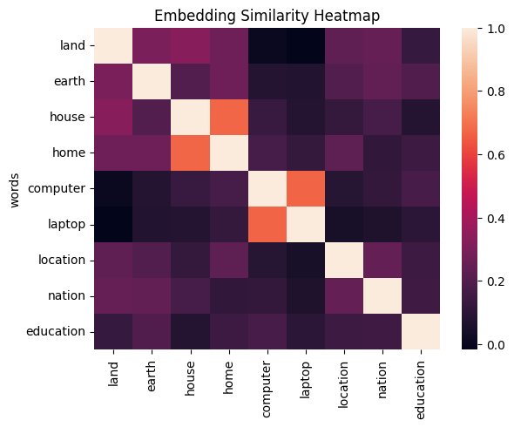
We want all words with a semantic similarity with general skills to extract to be selected from the input.

Slide 9
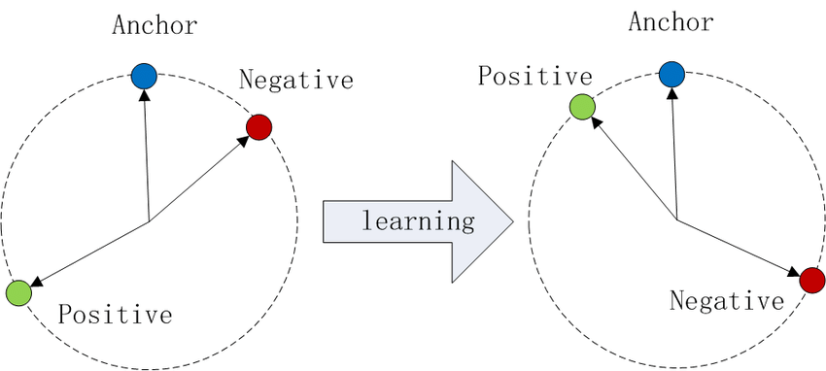
Technical Detail
An approach is to use triplet loss.
The goal is to train an anchor vector to be similar to our label (positive). Additionally, a “negative” sample can be used to increase dissimilarity with unwanted samples.

Slide 10
END

